Slide 1








IBM Data Analyst Capstone Project
Audry Surendra
August 2024

Slide 2

OUTLINE
Executive Summary
Introduction
Methodology
Results
Visualization – Charts
Dashboard
Discussion
Findings & Implications
Conclusion
Appendix

Slide 3

EXECUTIVE SUMMARY
Collected the top programming skills that are most in demand from various sources
Analyzed the data and identified insights and trends, including:
What are the top programming languages in demand?
What are the top database skills in demand?
What are the popular IDEs?
Applied statistical techniques to analyze the data
Created a dashboard using Google Looker

Slide 4

INTRODUCTION
I have recently been hired as a Data Analyst by a global IT and business consulting services firm that is known for their expertise in IT solutions and their team of highly experienced IT consultants
In order to keep pace with changing technologies and remain competitive, my organization regularly analyzes data to help identify future skill requirements
I have been tasked with collecting data from various sources and identifying trends for this year's report on emerging skills

Slide 5

METHODOLOGY
Data Collection
Collecting Data Using APIs
Collecting Data Using Webscraping
Exploring Data
Data Wrangling
Finding/Determining Missing Values
Finding/Removing Duplicates
Normalizing Data
Exploratory Data Analysis
Distribution, Outliers, Correlation
Data Visualization
Visualizing Distribution of Data, Relationship, Composition, Comparison
Dashboard

Slide 6

RESULTS

Slide 7
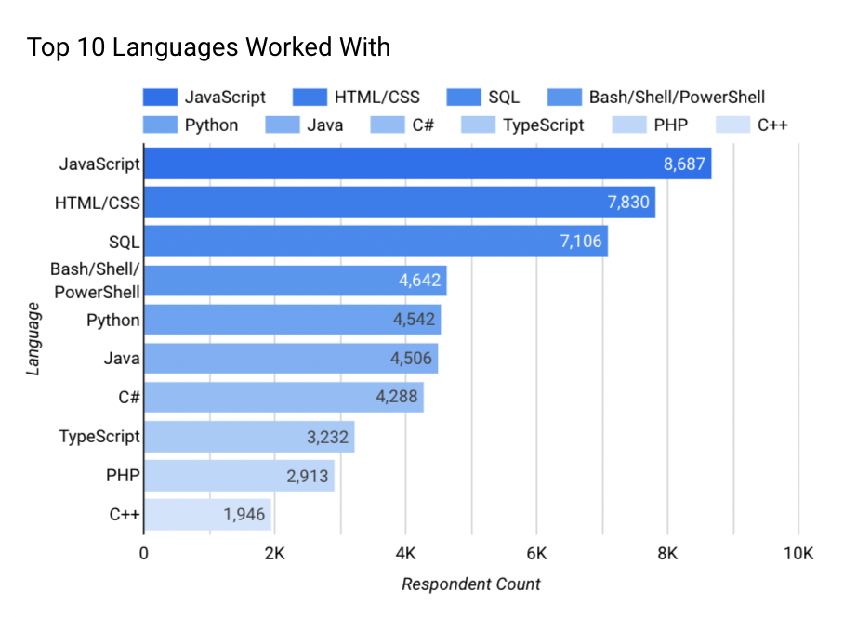
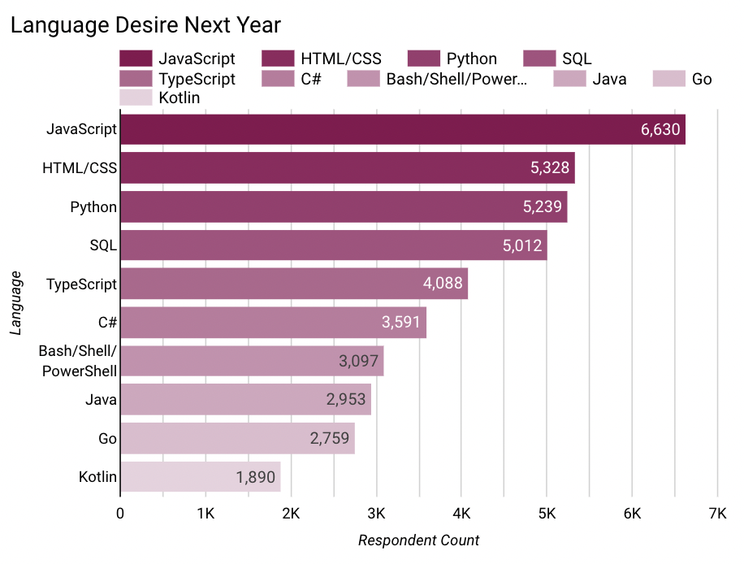
PROGRAMMING LANGUAGE TRENDS
Current Year
Next Year

Slide 8
PROGRAMMING LANGUAGE TRENDS - FINDINGS & IMPLICATIONS
Findings
Javascript, HTML/CSS, Python, and SQL are in the top 5 languages for this year and the next
Bash/Shell/Powershell is 4th for the current year, but drops to 7th in the next year
Typescript jumps from 8th in the current year to 5th for the next
Implications
Javascript, HTML/CSS, Python, and SQL have a steady demand and relevance
Bash/Shell/Powershell has had a decrease in demand
Typescript has had an increase in demand, and may be javascript’s main current competitor

Slide 9
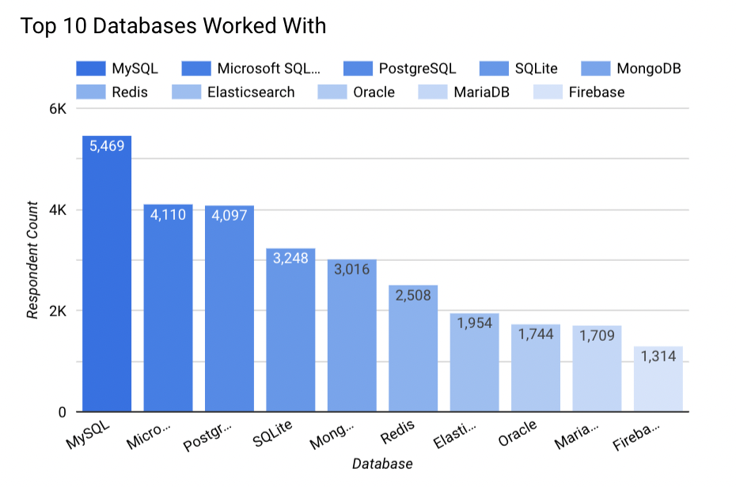
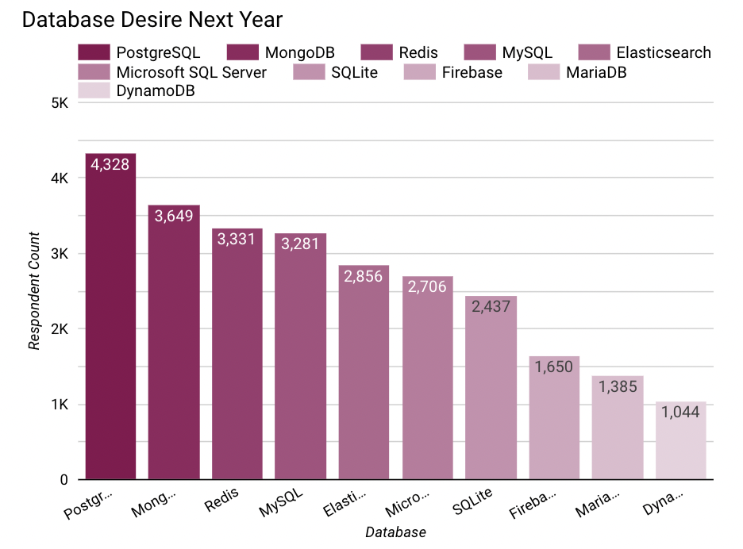
DATABASE TRENDS
Current Year
Next Year

Slide 10
DATABASE TRENDS - FINDINGS & IMPLICATIONS
Findings
MySQL and Microsoft SQL Server went from the top 2 to 4th and 6th, respectively
PostgreSQL went from 3rd in the current year to 1st in demand in the next
Redis and Elasticsearch both moved to the top 5 in the next year
Implications
There is a decrease in demand for MySQL and Microsoft SQL Server
PostgreSQL, Redis, and Elasticsearch all had increases in demand; since they’re all open source this suggests an increase in demand for open source databases

Slide 11
DASHBOARD
https://github.com/audrysurendra/IBM_data_analysis_capstone/blob/47950eaae418e6d2b6aa58866fbc7801485ce841/5.)%20Dashboard.pdf

Slide 12
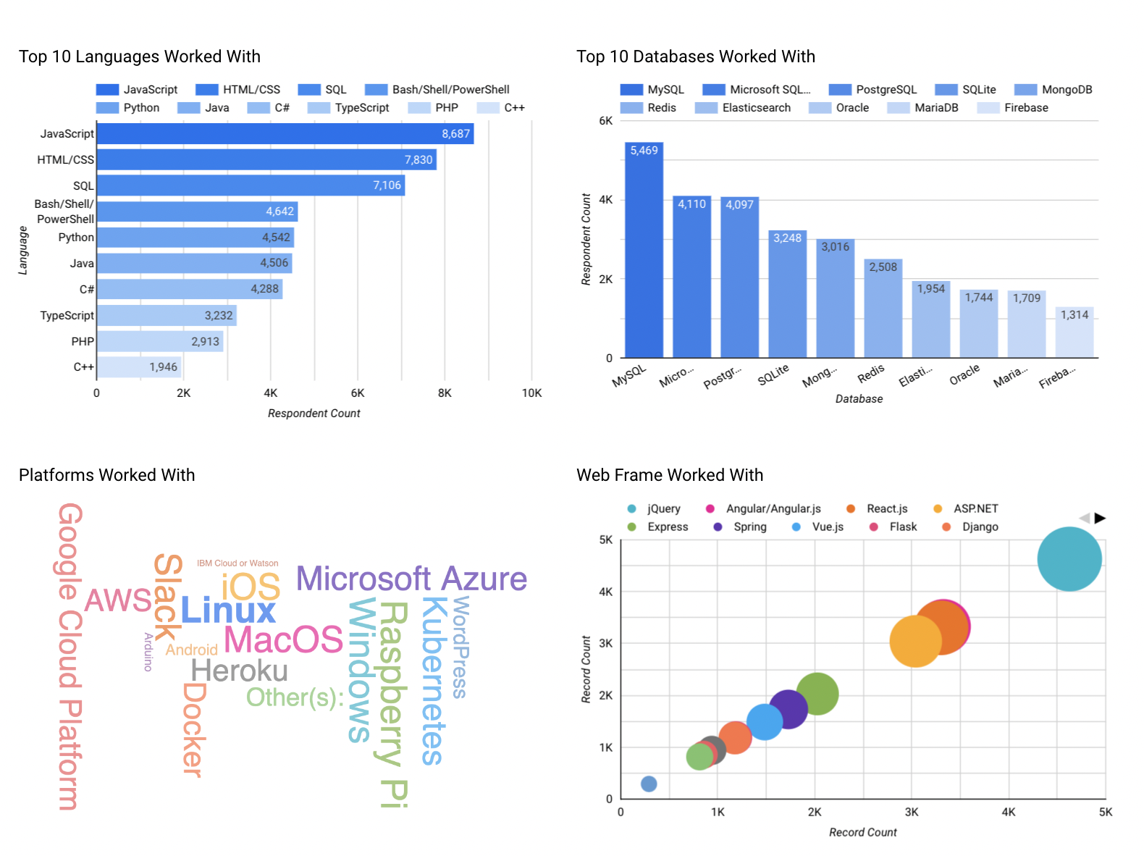
Current Technology Usage

Slide 13
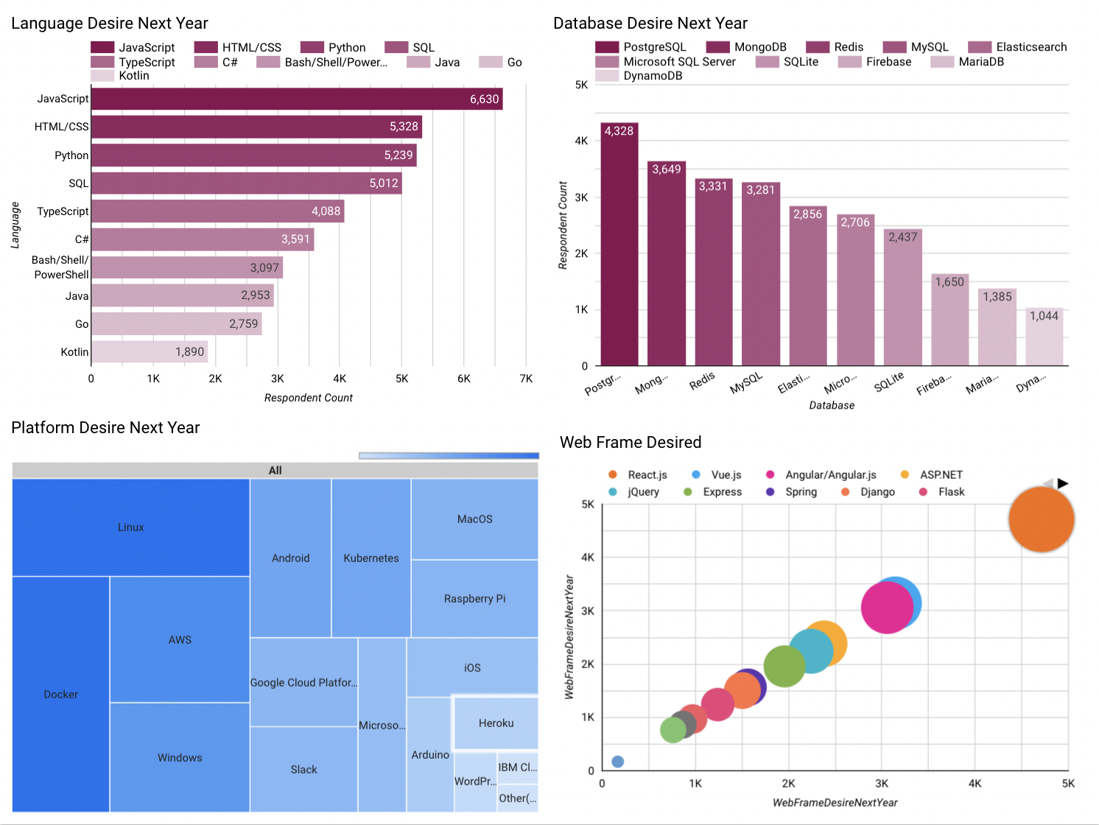
Future Technology Trend

Slide 14
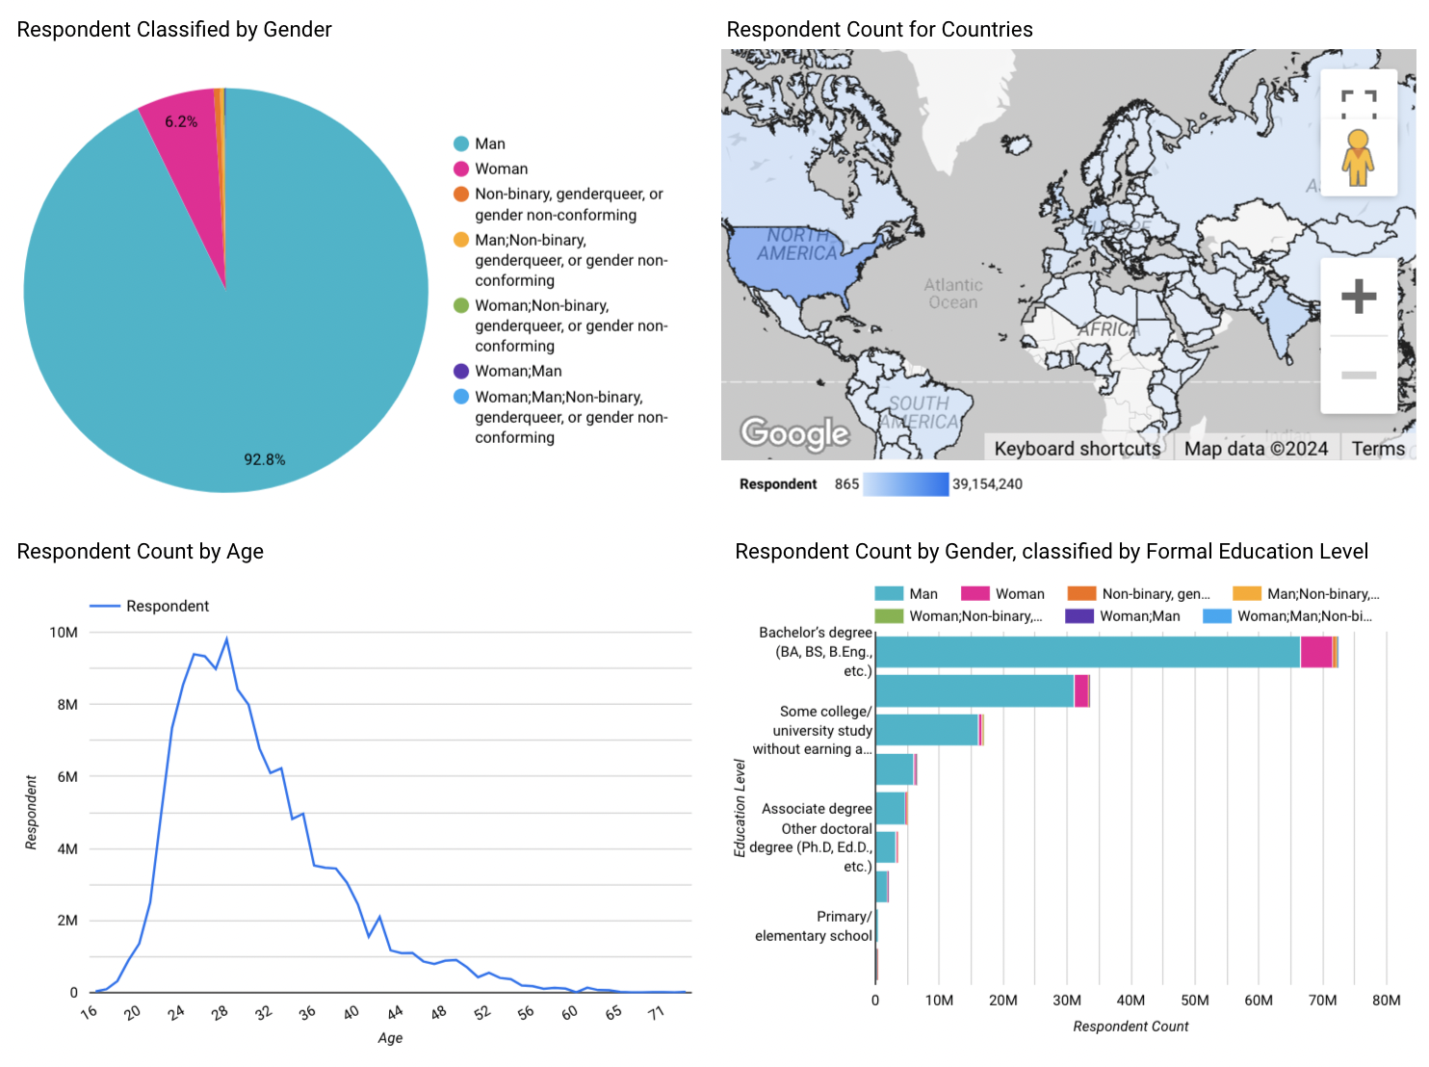
Demographics

Slide 15
DISCUSSION

Slide 16
OVERALL FINDINGS & IMPLICATIONS
Findings
Linux is one of the most popular platforms both this year and the next
Vue.js increased from the 7th to the 2nd most popular web frame
The most common demographic is men from developed countries, with a bachelor’s degree
Implications
Having Linux as a skill will be beneficial
There is an increase in demand for Vue.js
There is a lack of diversity in the hiring pool for IT

Slide 17

CONCLUSION
Javascript and HTML/CSS are currently the most in demand languages
PostgreSQL is the most upcoming in demand database
Varying trends means IT professionals need to be ready to adapt to different technologies as demand changes
There needs to be efforts made to diversify the IT field, i.e. by spreading more resources to developing countries, hiring more people from different educational backgrounds and gender identities, etc.

Slide 18

APPENDIX

Slide 19
JOB POSTINGS

Slide 20
POPULAR LANGUAGES

